Slide 1
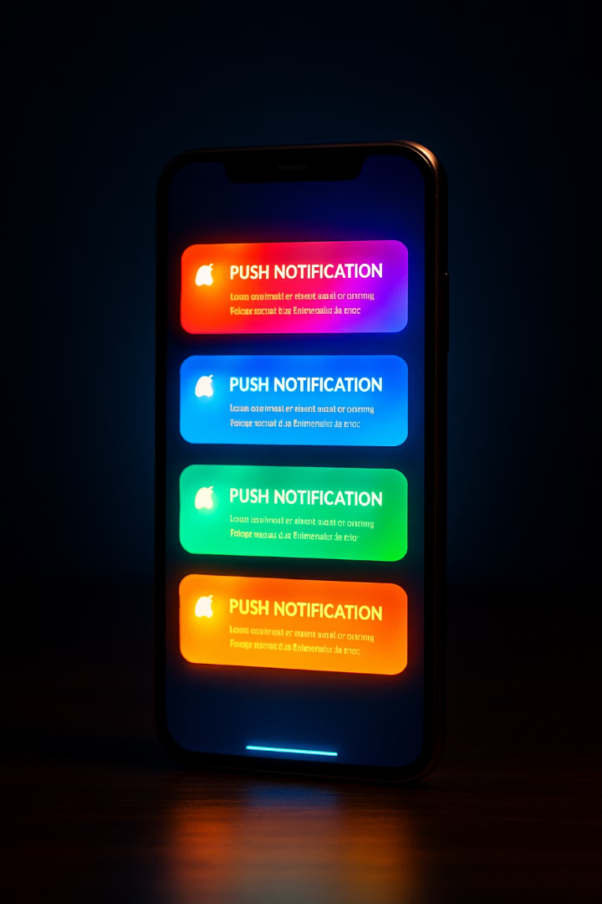
Notification Delivery Systems: Enhancing User Engagement
Welcome to an overview of notification delivery systems. We'll explore how these systems boost user engagement, compare key features, and analyze their pros and cons in mobile app development.

Slide 2
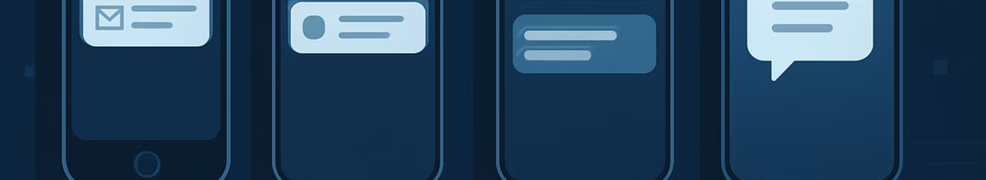



The Evolution of Push Notifications
2009
Today
Apple sends the first push notification
Billions of notifications sent daily
2010s
Rapid adoption across platforms

Slide 3
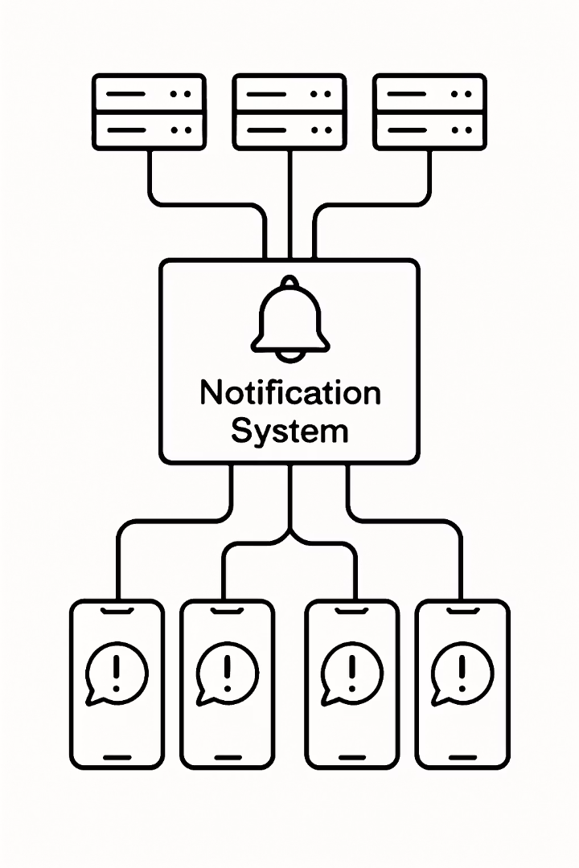



How Notification Systems Work
Developer Creates Message
App updates or promotions are prepared
Delivery System Processes
Message routed through notification platform
User Receives Alert
Notification appears on user's device

Slide 4
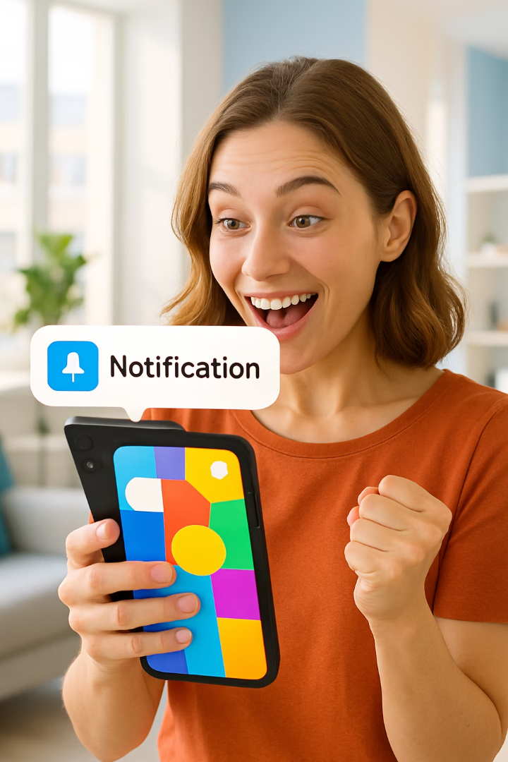




Driving User Engagement
Increase App Usage
Boost User Retention
Reminders prompt users to return to the app regularly
Regular updates keep users interested and engaged
Drive Sales
Promotions and deals encourage purchases

Slide 5
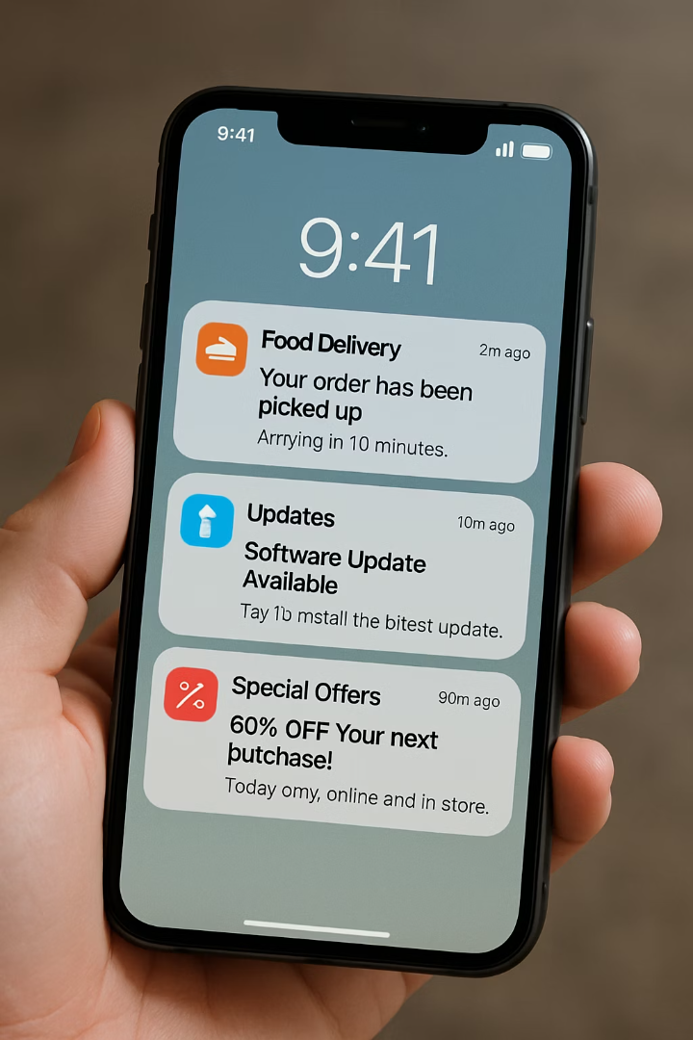
Engagement Examples
Food Delivery
Feature Updates
"Hungry? Order your favorite meal now."
"Check out our new voice messaging feature!"
Personalized Offers
"20% off your next purchase - today only!"

Slide 6








Firebase Cloud Messaging (FCM)
Google's Solution
Cross-Platform
Provided by Google for seamless integration
Works across Android, iOS, and web applications
Analytics
Topic Messaging
Integration with Google Analytics for tracking engagement
Target specific user groups based on interests

Slide 7
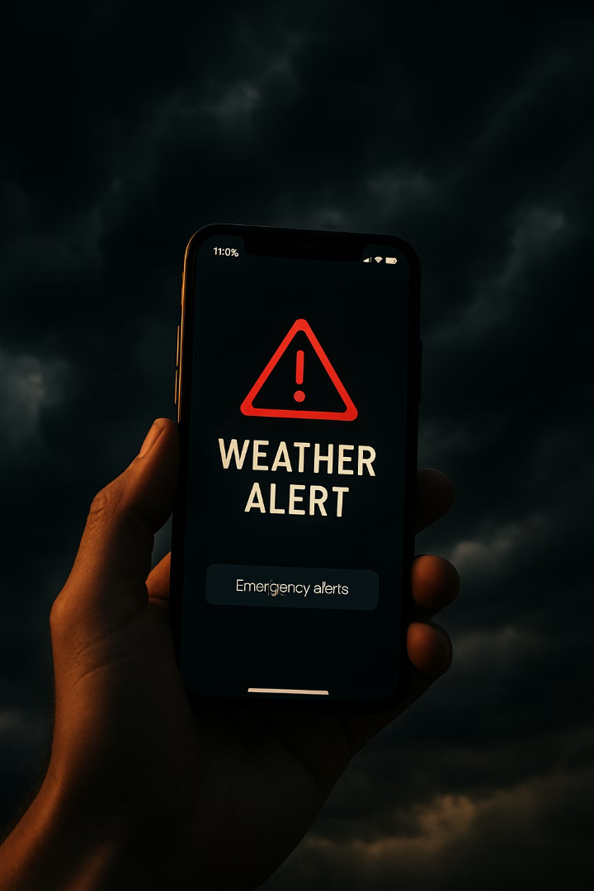
FCM in Action: Weather Alerts
Storm Detection
Weather service identifies severe conditions
FCM Processing
System targets users in affected areas
Alert Delivery
Users receive timely storm warnings

Slide 8



Implementing FCM
Set up Firebase SDK
Enable notifications in your app
Create notification logic
Define when and how notifications are sent
Use analytics for A/B testing
Find the most effective strategies

Slide 9
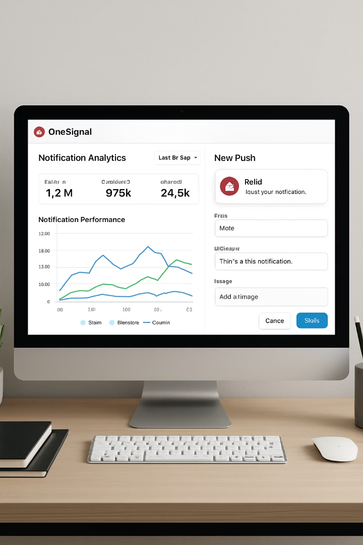



OneSignal: Key Features
Easy Integration
Rich Notifications
User Segmentation
Quick setup with minimal effort using simple SDKs
Send engaging messages with images, buttons, and videos
Target specific groups based on behaviors and preferences

Slide 10
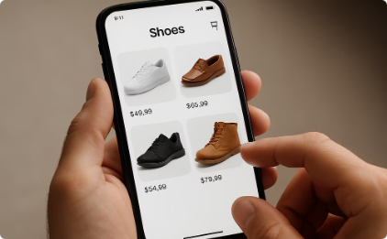
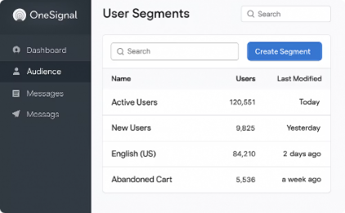
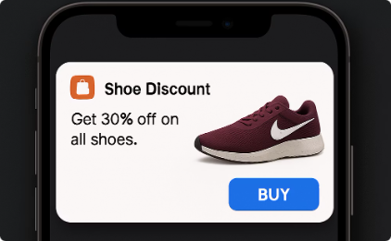
OneSignal Example: Retail App
User Browses Shoes
App tracks shopping behavior
Segmentation Occurs
System identifies user preferences
Targeted Notification
User receives personalized shoe offer

Slide 11
Alternative Notification Systems
Airship
Pusher Beams
Pushwoosh
Formerly Urban Airship, focuses on mobile engagement with advanced targeting based on user behavior patterns.
Designed for real-time messaging, allowing developers to send instant push notifications to users.
Offers multichannel messaging through push, email, SMS, and more for comprehensive user outreach.

Slide 12







Benefits of Notification Systems
Improved Engagement
Users return more frequently
Real-Time Communication
Deliver time-sensitive content instantly
Personalization
Tailor messages to individual behaviors
Multiplatform Support
4
Reach users across all devices

Slide 13








Challenges of Notification Systems
User Fatigue
Privacy Concerns
Too many notifications can overwhelm users
Data must be handled securely
Cost & Complexity
Internet Dependency
Advanced features increase expenses
Requires stable connection to function

Slide 14

Balancing Notification Strategy
Frequency
Limit notifications to avoid overwhelming users
Relevance
Ensure content is personalized and useful
Timing
Send at appropriate times based on user behavior
Value
Each notification should provide clear benefit

Slide 15
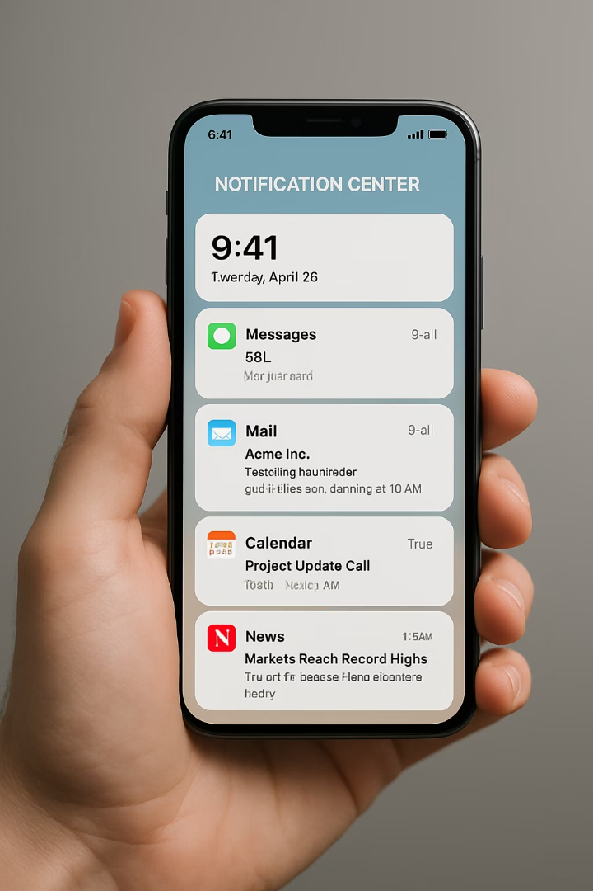
Key Takeaways
3+
4
Major Platforms
Key Benefits
FCM, OneSignal, Airship, and others offer unique features
Engagement, real-time updates, analytics, personalization
4
Challenges
User fatigue, privacy, connectivity, complexity

